Slide 1


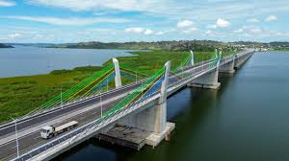
UNITED REPUBLIC OF TANZANIA
MINISTRY OF WORKS
TANZANIA NATIONAL ROADS AGENCY (TANROADS)
22nd EDITION OF PROJECT QATAR EXHIBITION AND CONFERENCE 9th- 11th JUNE 2026

Slide 2
TANZANIA ECONOMIC CONTEXT
Driven by tourism, agriculture, industry & construction and mining
The country’s population 62 million people with 51.9% of the working age population (NBS 2022).
Tanzania is located in East Africa with an area of 945,087 km²
Average GDP growth rate ranges from 5% - 6% a year for five years (2020-2025).
The economy is predicated to growth 6% in 2026 (World Bank& African Development Bank, 2025)
Notes:
Inapatikana kwenye Intranet, pamoja na miongozo mingine inayotumika TANROADS

Slide 3
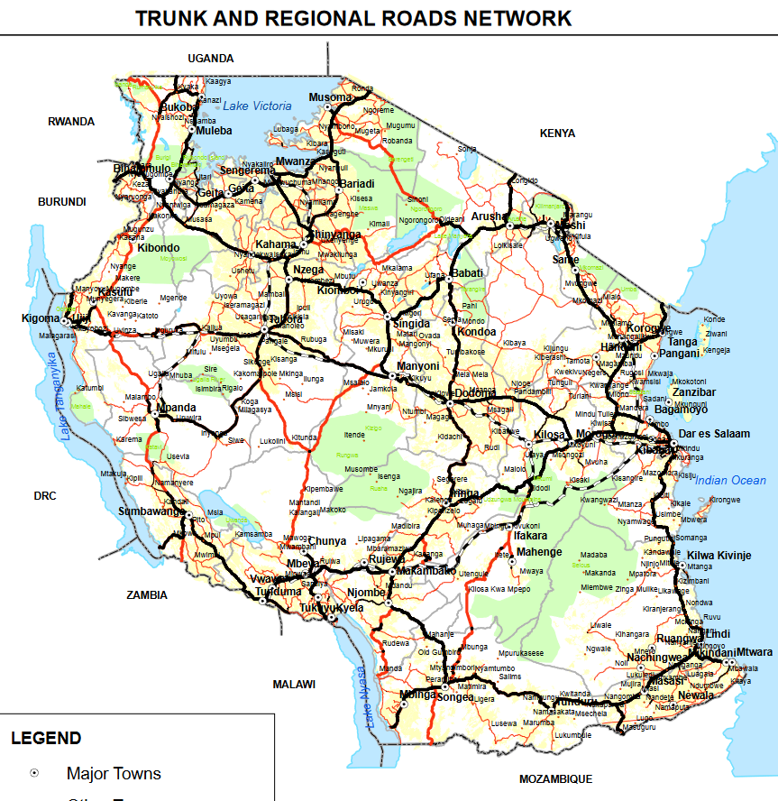

NATIONAL ROADS NETWORK
Tanzania National Roads Agency (TANROADS) was established by the Executive Agencies (The Tanzania National Roads Agency) (Establishment) (Amendment) Order, 2020, Government Notice No. 232, published on March 27, 2020. TANROADS administers 37,226km of national roads as classified below
Road Class | Paved (km) | Unpaved (km) | Total (km)
Trunk | 9,452 | 2,884 | 12,336
Regional | 2,577 | 22,313 | 24,890
Total | 12,029 | 25,197 | 37,226

Slide 4
PRIVATE SECTOR AS ALTENATIVE SOURCE OF INFRASTRUCTURE FINANCING
Growing demand of roads infrastructure, Government constraints on public resources and fiscal space thus Private Sector is an alternative source of supplementing the limited resources
To facilitate the PPP Concept, the Government established PPP framework (National PPP Policy, PPP Act Cap 103 and its Regulations)
TANROADS has identified several projects, which may be implemented through PPP modality or other alternative financing options .
The projects were identified in consideration of Government’s Priorities and indication on Affordability, Financial Viability & Bankability and other factors attracting the PPP investments.

Slide 5
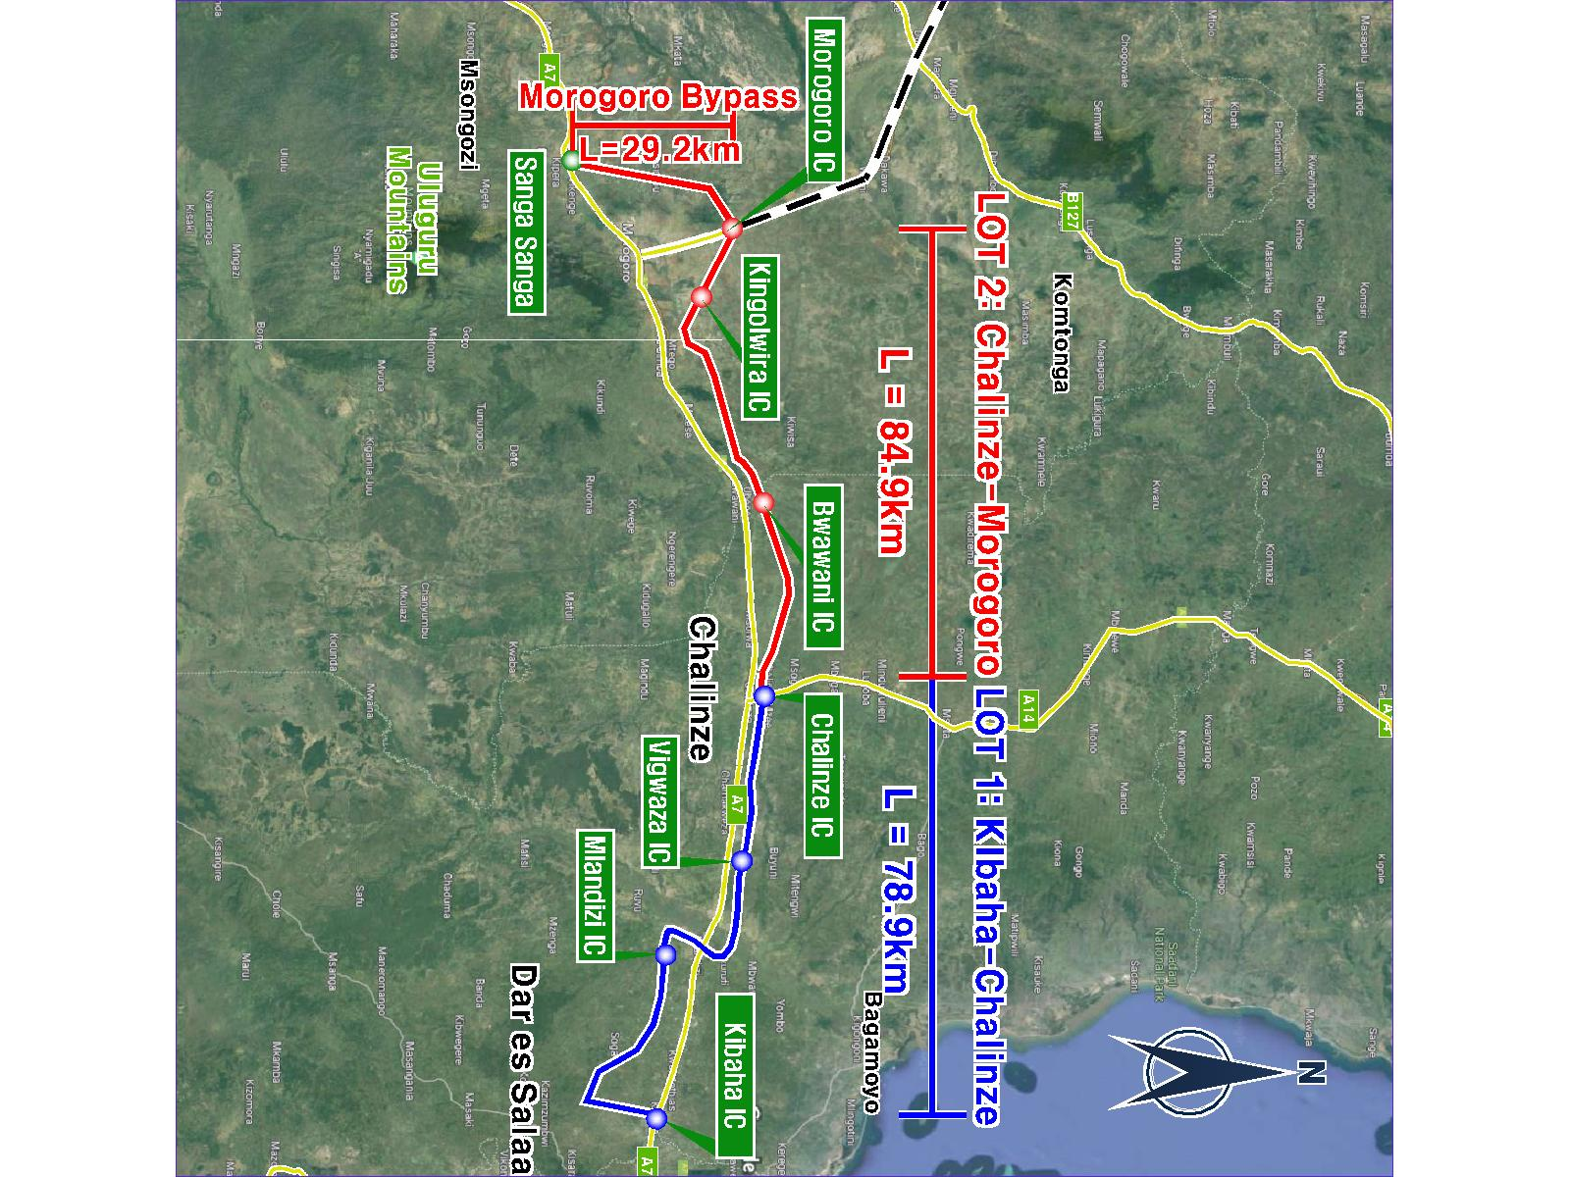
PPP PROJECTS PIPELINE
1. Chalinze-Morogoro (84.9km) Expressway
The Feasibility Study completed in 2025
Over 90% of Cargo from DSM port pass through existing highway
High traffic demand, AADT 32,850
  CAPEX & OPEX is $442 & $188 (in real terms) respectively
NPV= $54.9 million, IRR = 17.1%, toll revenue= $ 4.99 bio, rental revenue= $ 1.2 bio
  Looking for ;
Private Partner to develop a green field toll road through PPP model
(Payment mechanism- Availability Payment)

Slide 6
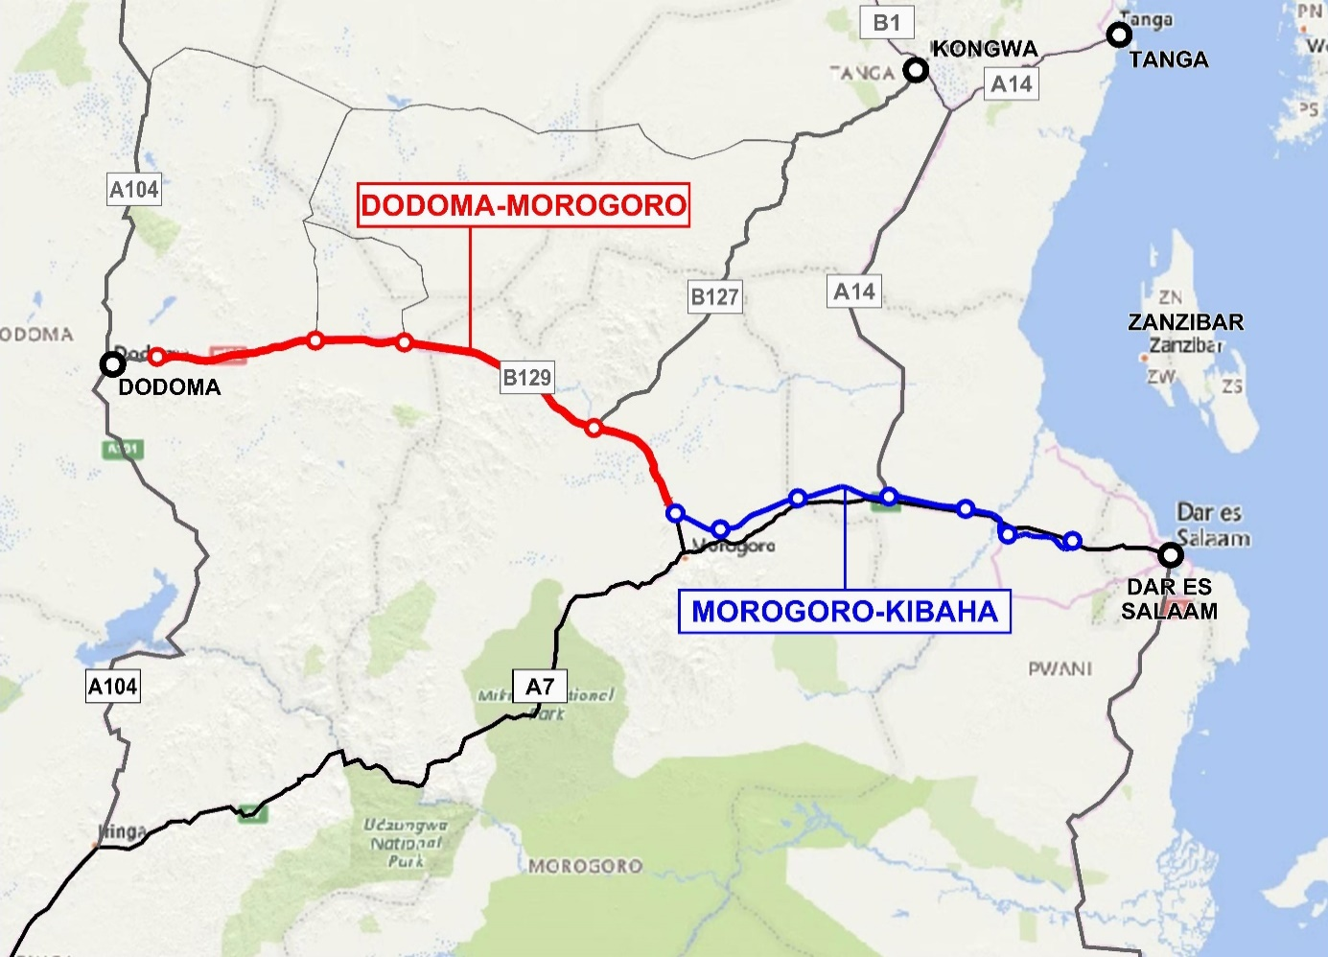
PPP PROJECTS PIPELINE
2. Morogoro-Dodoma Expressway (260km)
Economic study, DED & ESIA was completed in 2022
The main link in Central Corridor, connects DSM with Dodoma
About 30% of transit cargo from DSM port use this corridor
Traffic demand, AADT 22,731
  Estimated construction cost $ 700 million brown field (2 lanes to 4 lanes)
  Needed;
Alternative financing (PPP, bond etc.) to fund the project)

Slide 7
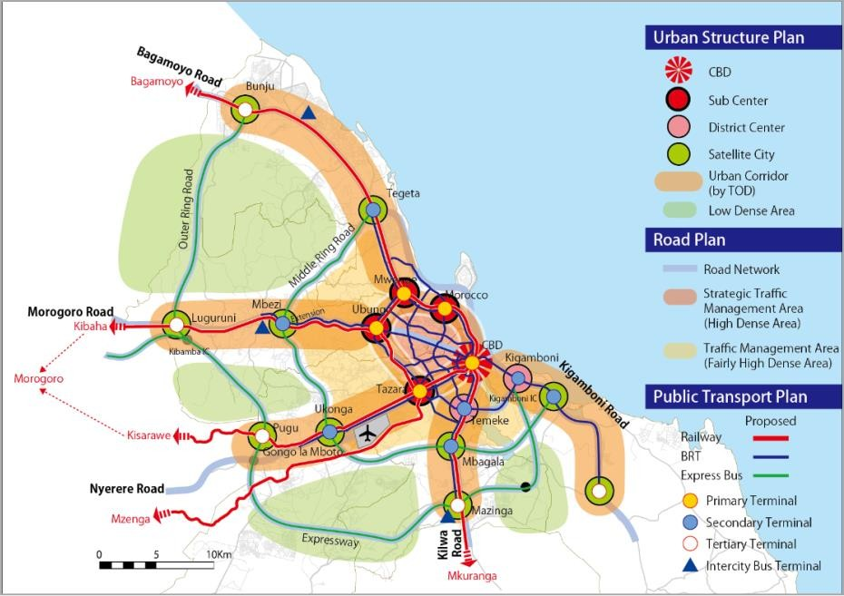
PPP PROJECTS PIPELINE
3. Dar es Salaam Outer Ring Road (78km) & Middle Ring
Road (53km)
To decongest Dar es Salaam city, the Dar es Salaam City Transport Masterplan, JICA (2018) Pre-Feasibility Study is completed DSM population by 2035 will be 13.4 million. Estimated CAPEX is $505 million for middle ring road & $530 million for outer ring road IRR=11.0% , NPV=25.9mio (middle) IRR = 10.98%, NPV =17.9 mio (Outer)
  Looking for;
Project financing to develop green field road toll through PPP model
(payment mechanism-AP)

Slide 8
PPP PROJECTS PIPELINE
4.Kitonga Bypass/Tunnel
This is a section of Tanzania-Zambia highway Heavily congested mountainous section (11km) with steep grades and sharp curves Prone to road crashes and frequent truck breakdown 70% of cargo from DSM port cross this section Feasibility Study for 27km bypass road is under preparation (conventional)
  Needed
Project financing to develop green field toll bypass/tunnel through PPP model

Slide 9
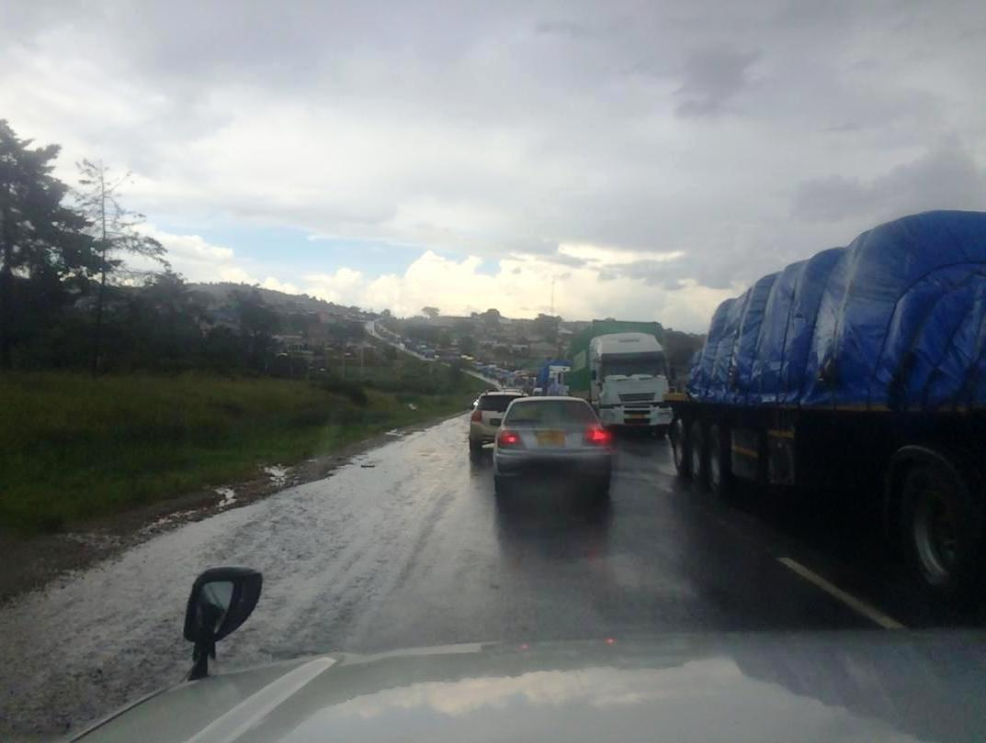
PPP PROJECTS PIPELINE
5. Igawa- Tunduma (218km) and Uyole – Songwe bypass (48.9km)
70% of cargo from/toward DSM port cross this highway Gateway to Zambia, DRC, Zimbabwe &Malawi In 3 yrs transported 13% increase in cargo which is estimated to increase by 30% in 2029/30 Estimated CAPEX is $ 600 mio Traffic, AADT 17,276 Feasibility Study under preparation
  Looking for;
Lenders to finance development of brown field toll road through PPP model
(Payment mechanism- user pays & AP)

Slide 10
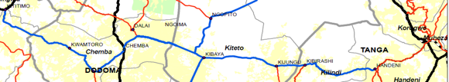
PPP PROJECTS PIPELINE
6. Handeni-KwaMtoro- Singida (384km)
The Feasibility Study completed in 2016, Economic Study updated in 2026
Shortest route from Tanga port to Rwanda, Burundi, Uganda & eastern DRC
Government is upgrading the Tanga port to be competitive
Cargo volume via Tanga port to/from hinterland has grown significantly
Estimated CAPEX is $ 600 million
  Looking for ;
Private Partner to develop a green field - truck dedicated toll road (single carriageway

Slide 11
ESTIMATED PROJECT COST FOR
PPP PROJECTS PIPELINE
  The estimated project cost of all six pipeline project is USD 3.6 billion
  It is estimated that these pipeline projects will be implemented within 5 to 10 years
  Financing need ;
Project financing through PPPs (from developers/lenders)
Blended financing mechanisms from lenders, bond, DFIs

Slide 12
Government Support for PPP projects and Risk Mitigation
To improve PPP project bankability;
PPP Act Cap 103 provides government support to PPP projects
Support include public funding (fiscal commitment or contingent liabilities)
Other support include tax and non-tax incentives
Guarantees (payment guarantee, demand guarantee)
Risk mitigation from Government
Land acquisition for construction corridor (R.O.W)
Environmental &Social risks compliance
Guarantees (payment & demand guarantee)
Exchange rate risk (hard currency vs local currency)

Slide 13
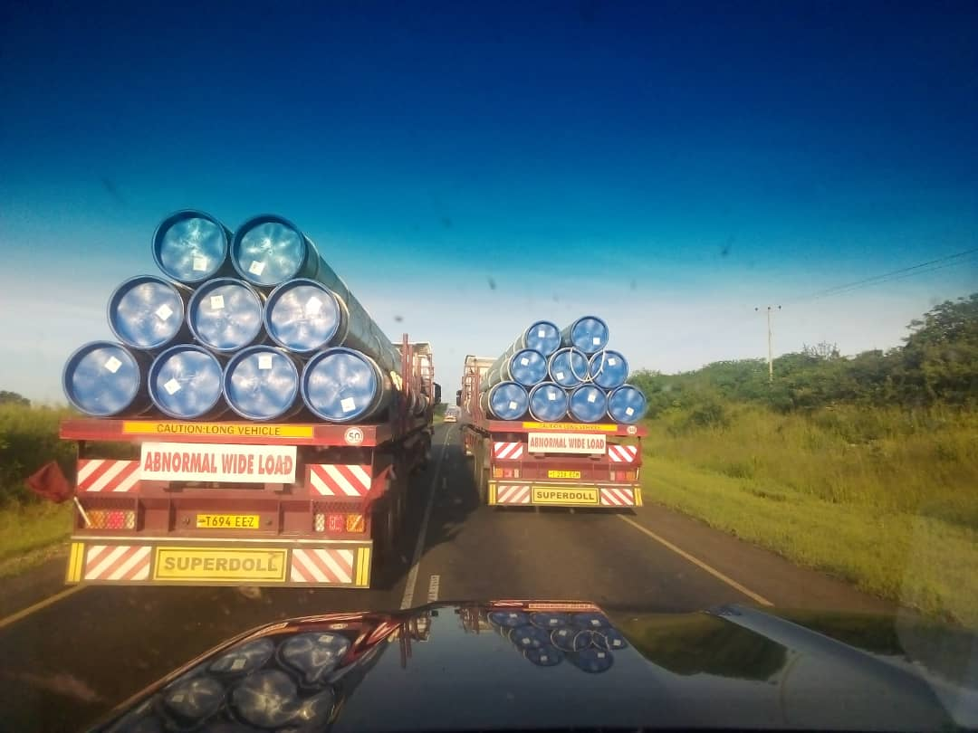
ROADS ARE A LIFELINE TO THE ECONOMY
THANK YOU
For more details please contact:
Website: www.tanroads.go.tz
Email: tanroadshq@tanroads.go.tz/elibariki.mkumbo@tanroads.go.tz
+2552222926001/6 or +255787014096 (watsApp)

